Slide 1
Aquifer Storage Recharge
Justin & David

Slide 2
Situation
40 000 m^3 in August & July
10 < k < 40 [m/d]
0.25 < φ < 0.5 [-]
0.5 < α < 2 [m]
20m
Salt = 30g/l

Slide 3
Time planning
Divided work that needs to be done | Amount of time need to put in per person | Finished before | Planned working days
Literature search | 16 hours | 22/Dec | 20 and 21 December
Design ASR system | 16 hours | 10/Jan | 08/Jan
Producing schedule for injection, extraction and storage | 8 hours | 11/Jan | 10/Jan
Reduce waste of injected drinking water | 8 hours | 18/Jan | 12/Jan
Apply guidelines for injection pressure and maximum velocity | 8 hours | 22/Jan | 18/Jan
Run model for 10 years with a start-up year and less extracted volume | 8 hours | 24/Jan | 22/Jan
Making conclusion and finish report | 8 hours | 25/Jan | 24/Jan

Slide 4
Literature search
Comparable systems
Good practice
Idea of feasibility
Rules of thumb
Choose location?
Get guidelines for injection pressure

Slide 5
Comparable systems

Slide 6
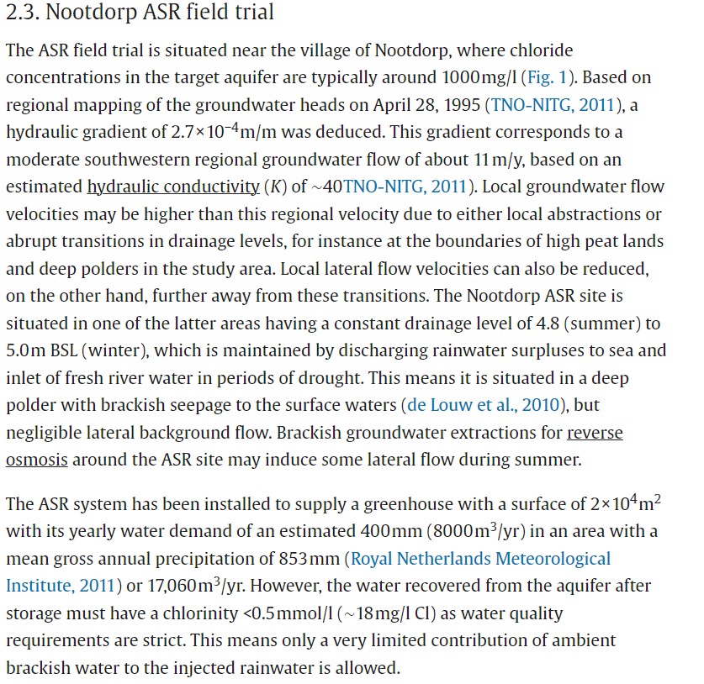
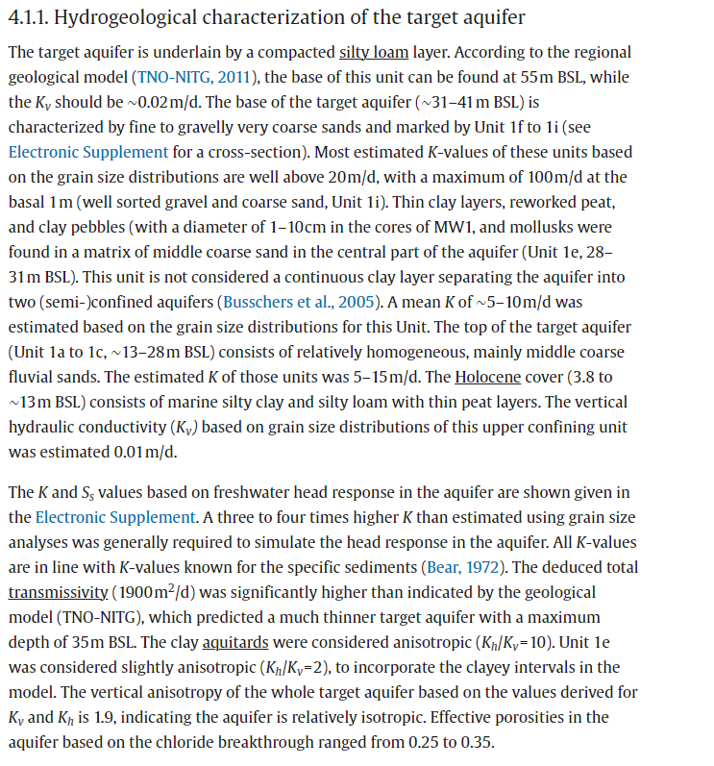
Nootdorp

Slide 7
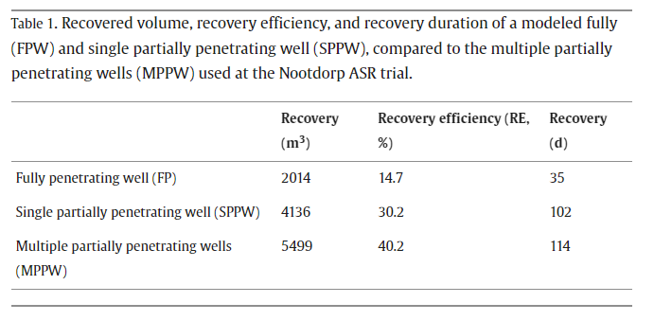
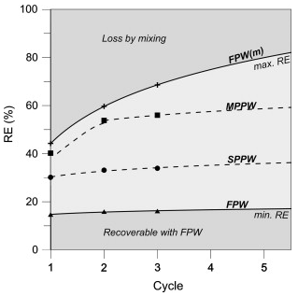
Nootdorp

Slide 8
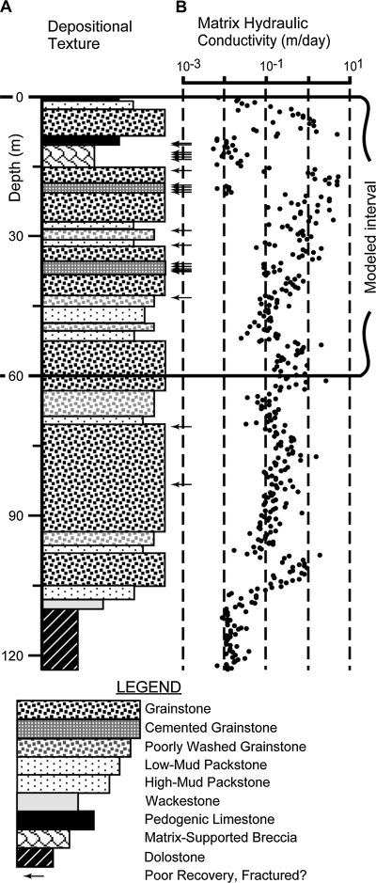
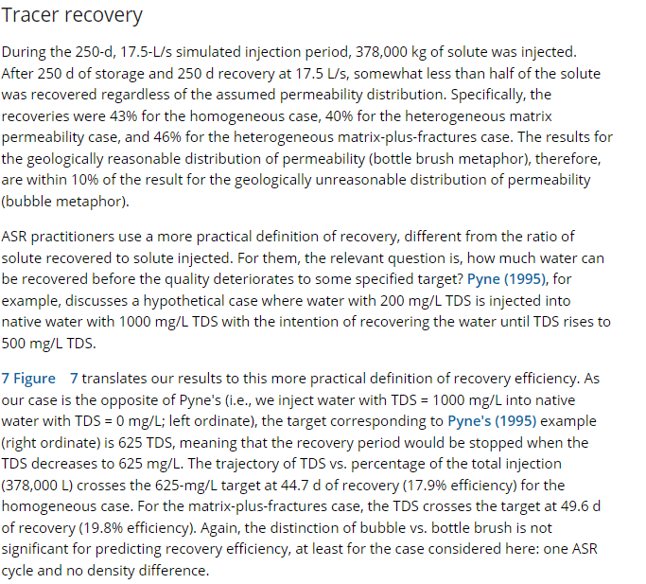
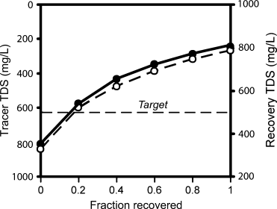
Florida

Slide 9
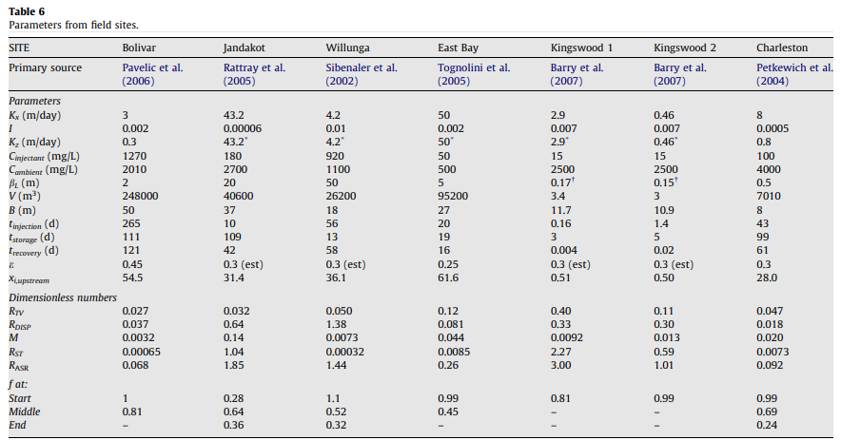
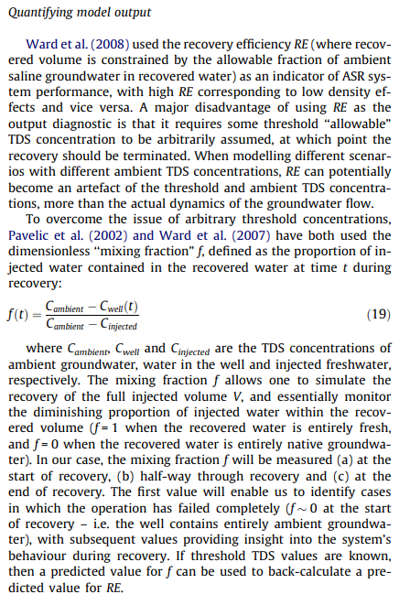
Several

Slide 10
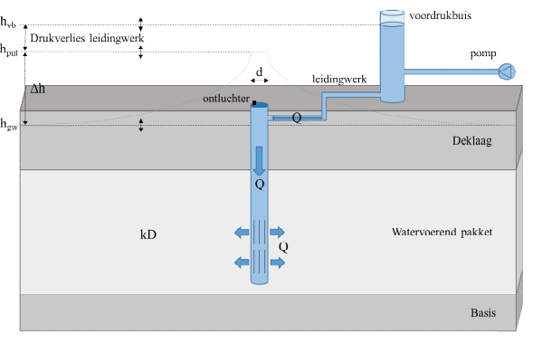

Maximum infiltration rate
Infiltration
Follows from maximum infiltration pressure:
(De Glee)
k = hydraulic conducitivity of aquifer (m/d)
D = thickness of aquifer (m)
c = hydraulic resistance of confining layer (d)
r_{well} = well radius (m)
h_{in} = infiltration head (m + land surface)
h₀ = natural hydraulic head in aquifer (m + land surface)
In practice: decreases due to gradual well clogging
$$Q_{in}=\frac{2πkD\left(h_{in}−h_{o}\right)}{\ln\left(\frac{\sqrt{kDc}}{r_{well}}\right)}$$
h_{in}
h₀
Van Dooren et al. (2020): https://library.kwrwater.nl/publication/61802381/

Slide 11
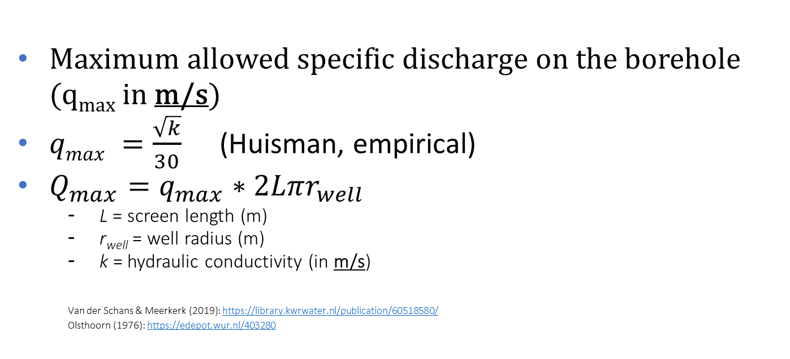
Particle mobilization
Extraction
Maximum allowed specific discharge on the borehole (q_{max} in m/s)
$qmax =\frac{\sqrt{k}}{30}$ (Huisman, empirical)
$Q_{max}=q_{max}∗2Lπr_{well}$
L = screen length (m)
r_{well} = well radius (m)
k = hydraulic conductivity (in m/s)
Van der Schans & Meerkerk (2019): https://library.kwrwater.nl/publication/60518580/
Olsthoorn (1976): https://edepot.wur.nl/403280

Slide 12
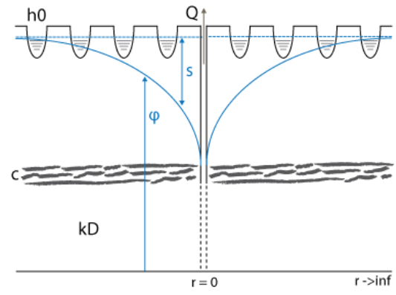
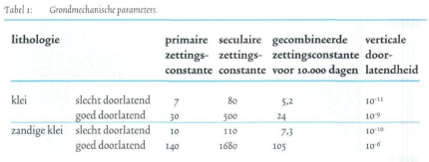
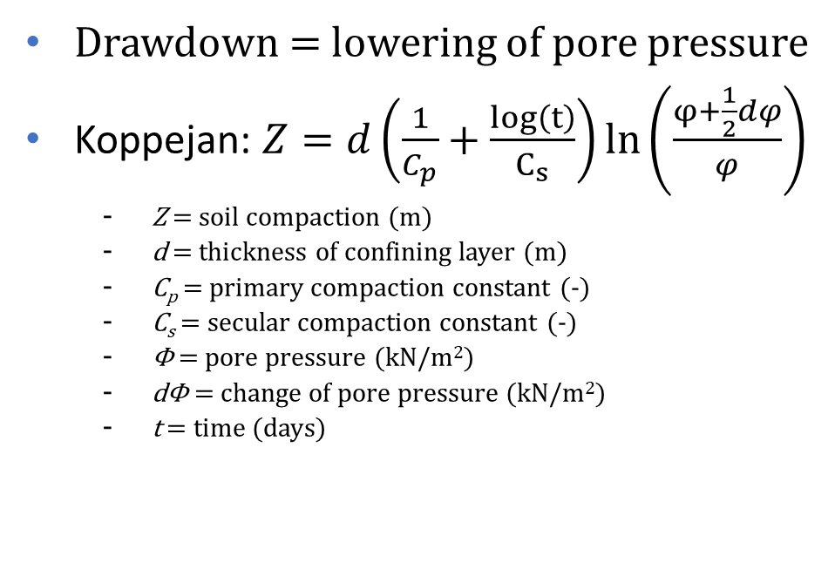
Soil compaction ‘zetting’ (in Dutch)
Extraction
Drawdown = lowering of pore pressure
Koppejan: $Z=d\left(\frac{1}{C_{p}}+\frac{log\left(t\right)}{C_{s}}\right)ln\left(\frac{φ+\frac{1}{2}dφ}{φ}\right)$
Z = soil compaction (m)
d = thickness of confining layer (m)
C_{p} = primary compaction constant (-)
C_{s} = secular compaction constant (-)
Φ = pore pressure (kN/m²)
dΦ = change of pore pressure (kN/m²)
t = time (days)
http://www.grondwaterformules.nl/index.php/formules/onttrekking/deklaag-zonder-rand-de-glee
Drijver (2002): https://edepot.wur.nl/358642

Slide 13
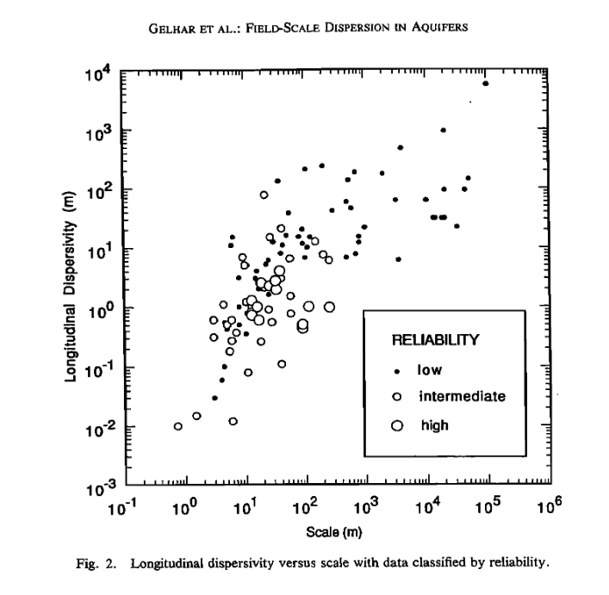
Dispersivity
0.2 < α_{L} < 95
0.5 < α_{L} < 2.0

Slide 14
Design ASR system
MODFLOW6 model
Adjust parameters
Background flow?
Optimise model to reduce waste
Ensure guidelines for injection pressure and maximum velocity are met
Run model for 10 years with a start-up year and less extracted volume

Slide 15
Producing schedule for injection, extraction and storage
Injection
Analysis of when water excess
Extraction
Water deficit – July & august:
Schedule for 1 year & 10 years
Storage possibly above ground if pumping rate too low

Slide 16
Report
Discuss the uncertainties in your design.
Changes in Kh
Scenarios?
Present findings

